Slide 1
Uncertainty, Validation and Modeling

Slide 2
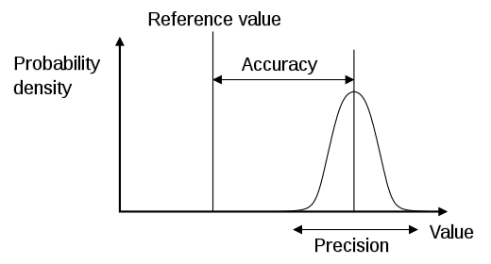
Precision vs. Accuracy vs. Uncertainty
Measurements (Errors)
Precision: The ability of a measurement to be consistently reproduced
Accuracy: The ability of a measurement to match the actual value of the quantity being measured
Modeling (Uncertainty)
Uncertainty: The estimated amount or percentage by which an observed or calculated value may differ from the true value
Notes:
So that we help the discussion along let’s look at some definitions and come to an agreement as to what they mean without getting into any academic debate about the merits of the definitions.
Usually, when referring to measurements directly or indirectly “precision” and “accuracy” are the preferred terms.
When dealing with predictions or modeling, then the “uncertainty” term would be preferred.
However, others can argue that errors and uncertainty are not very different. At one level both can describe the deviation of a true (measured) value from predicted (either via analytical method or modeling). Analytical methods are also modeling in some sense as we use chemicals or sensors to measure a certain quantity and generate a number (prediction), but we know with certainty that the number varies slightly each time we perform the same analysis. The true value in a sense is like a moving target.

Slide 3
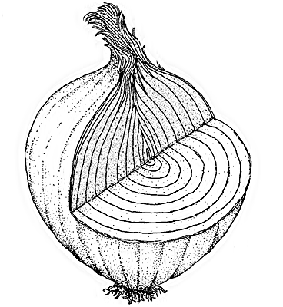
Peeling the Errors/Uncertainty Layers
Possible sources of Errors:
Laboratory methods (precision estimates):
Between Laboratories Reproducibility (R);
Within Laboratory:
Reproducibility (R_{L});
Repeatability (r).
Field methods
Possible sources of Uncertainty (Modeling):
Pedotransfer Functions (ptf);
Spatial Data;
Spatial Predictions (Mapping);
Database Transactions;
Pedon Accuracy Locations (PLS vs GPS);
Interpretations (ongoing).
Notes:
So, now that we established some common understanding, addressing the sources of the uncertainties is similar to peeling onion rings. There are many layers of uncertainty and each time we measure or make a decision the uncertainty by default follows.
The question then becomes about the influence of these sources (measurements or decisions) on the uncertainty predictions.
More specifically, Can we quantify their magnitude and bias and
how than can these be incorporated into the predictions?
The examples that follow elaborate on some of the sources or errors/uncertainties related to Soil Survey in particular. We will try to go down the list and provide some quantitative assessment of the errors/uncertainties.
We may come short of reasonable solutions, something to think about.

Slide 4
Analytical Methods - Measurements
These three precision estimates are measures of the spread of results when a sample is analyzed repetitively under specified conditions, with 95% confidence that results would fall within ± (R, R_{L}, or r) of the mean:
Between Laboratory Reproducibility(R) : is a measure of the agreement between results obtained by the same method on identical test materials under different conditions (e.g., different laboratories, different analysts, different equipment, etc.);
Within Laboratory Reproducibility “R_{L}” : is a similar measure but within the same laboratory;
Within Laboratory Repeatability “r” : measures the agreement between results obtained within the laboratory by the same method on identical test material under the same conditions (e.g., same analyst, same day, same equipment, etc.).
Pedotransfer Funtions (ptf) - Modeling
Notes:
We will start with the measured soil properties via analytical methods as they are at the core or foundation of almost all our mapping.
The three definitions of the error are related to the ability of a method to yield a particular number from the same set of samples analyzed by different laboratories (R), different individuals, (RL) and same individual on same sample (r).
The SSL participates in the International Soil Exchange, and receives 4 samples quarterly from Wageningen University (Wageningen, 2010), There are about 20 or so laboratories around the world that participate.
The other source of uncertainty of the use of what we call pedotransfer functions (ptf) to predict (model) a measured soil property from another measured soil property.
We will use soil pH as an example from some work that the KSSL did as part of the GlobalSoilMap project.

Slide 5
Pedotransfer Funtions (ptf) Modeling
The files with the data for this example are:
pH Data_PTF.xlsx and
pH Data_PTF.txt
pH Data_PTF.csv
Notes:
KSSL uses 1:1 water and 1:2 caCl2 to measure soil pH. The GlobalSoilMap specifies that the soil pH would be 1:5 water. So we determine the soil pH 1:5 on samples that had previously been measured for pH 1:1 wand 1:2 CaCl2 and conducted a regression analysis.
As you can see the RMSE between predicted soil pH 1:5 W using soil pH 1:1 W is 0.44 pH units almost half unit. When considering the range of pH (3-11) 0.44 unit could be significant or not depending on what decision we would make, for example liming.
And this is only one simple model we used to predict soil pH 1:5 W.
How does this RMSE compares to the errors associated with the difference between and within laboratories?
Exercise: A simple R code to run a regression and some residuals and plot them graphically. Print the info to see the model performance.
Use: “pH_ptf.R” Script and pH Data_PTF.csv or txt

Slide 6
Error source and magnitude associated with analytical pH methods (R, R_{L}, r) and pH1:1_{W} predictor for pH1:5_{W} (ptf)
r
ptf
R_{L}
R
Notes:
The biggest source of error as expected is the between laboratory analysis. The second offender is the ptf then the last one as expected is repeated analysis on the same sample by the same individual (precision).
We have established that there are errors associated with analytical methods and that is not surprising, but that should give us some perspective right from the start about future transections and predictions we will make based on these measured data.

Slide 7
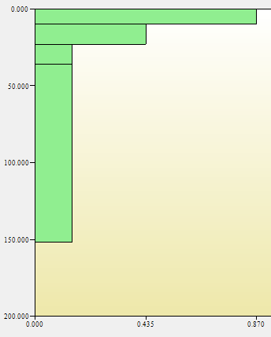
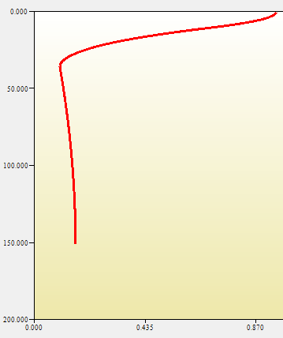
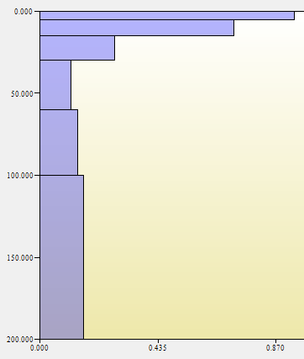
Fitting splines (Modeling)
Splines (ver. 0.1–0.9):
Fit equal-area splines to SSURGO/STATSGO components (viz. Malone et al. 2009, Bishop et al. 1999)
Derive property values at GSM standard depth increments (0-5, 5-15, 15-30, 30-60, 60-100, 100-200 cm)
Soil profile with property data
Continuous spline
(1 cm resolution)
Property estimates at specific increments
Notes:
One of the charges of the GlobalSoilMap project is to generate the property maps for standard depths up to 2 m. In order to generate such maps for specified depths the Spline approach has been proposed. In essence the spline is a quadratic function that forces the line through the measured or estimated data points for soil properties. This creates a continuous representation of the soil property with depth by interpolating between measured/estimated data points.
As simple and attractive this approach is for many reasons, it also introduces again uncertainty. This is no different from the previous ptf example.

Slide 8
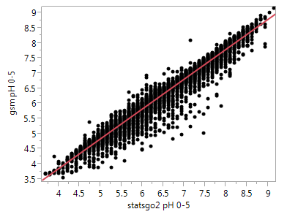
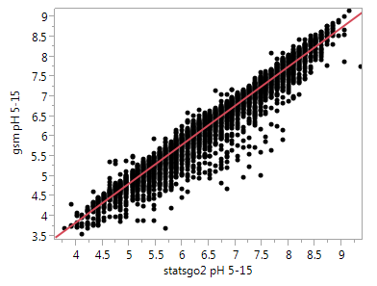
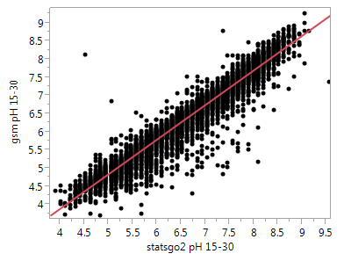
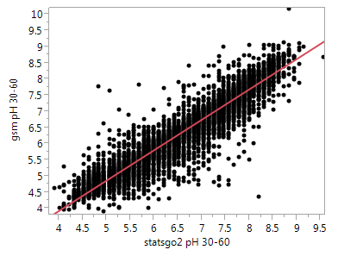
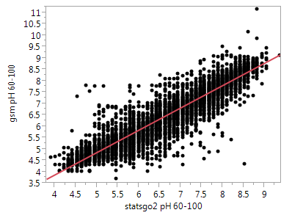
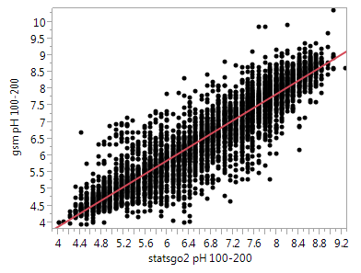
Pedotransfer Funtions (ptf) - Modeling
0-5 cm
5-15 cm
15-30 cm
R2 = 0.96
RMSE = 0.21
Mean = 6.4
R2 = 0.96
RMSE = 0.22
Mean = 6.4
R2 = 0.94
RMSE = 0.28
Mean = 6.5
30-60 cm
60-100 cm
100-200 cm
R2 = 0.91
RMSE = 0.35
Mean = 6.6
R2 = 0.89
RMSE = 0.40
Mean = 6.7
R2 = 0.89
RMSE = 0.40
Mean = 6.8
The RMSE doubles with soil depth from 0.21 to 0.40 pH units
The files with the data for this example are: pH gsm vs statsgo2_PTF.xlsx; pH gsm vs statsgo2_PTF.txt and pH gsm vs statsgo2_PTF.cvs;
Notes:
We will stick with the soil pH example to simplify things.
Here we compare the soil pH values from STATSGO2 for the standard depths generated through Spline versus those generated by slicing the same pedon data at the specified GSM.
The x axis shows the soil pH values from slicing, while the y-axis the pH values from spline.
Notice how the RMSE increases with depth. This introduces another source of uncertainty. Of course, we still have to compare them with the measured values from pedons, but the thing to emphasize here is that this modeling is similar to the database transactions done many times within our databases especially NASIS. We will show this with other examples later.
Exercise: A simple R code to run a regression and some residuals and plot them graphically. Print the info to see the relationships.

Slide 9
Peeling the Errors/Uncertainty Layers
Possible sources of Errors:
Laboratory methods (precision estimates):
Between Laboratories Reproducibility (R);
Within Laboratory:
Reproducibility (R_{L});
Repeatability (r).
Field methods
Possible sources of Uncertainty (Modeling):
Pedotransfer Functions (ptf)
Spatial Data;
Spatial Predictions (Mapping);
Database Transactions;
Pedon Accuracy Locations (PLSS vs GPS);
Interpretations (ongoing).
Notes:
So far we are not considering spatial predictions and how do they influence the uncertainty and predictions.
We have been in the spatial prediction business for a very long time. Our SSURGO maps are a good example of such qualitative/class models. Soil taxonomy is another model build on a combination of words and numbers applied in space.
The only things that seems to change/evolve is the approaches to modeling which very much are determined by the status of knowledge and availability of data input.
So spatial modeling is as good as data itself and the user’s brain.
We will start with elevation data and walk through steps to build a predictive model either class or property based. In the process we hope to elaborate on sources of uncertainty and how we could potentially address some of them.

Slide 10
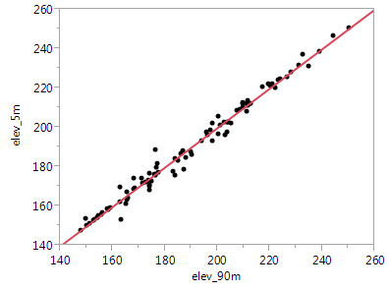
Elevation is one of the Primary Data Source for Digital Soil Mapping
For NOW assume that the Elevation is accurate and that we only have ONE data source (2005 High resolution aerial Image – Indiana example)
Dillon_Cr_WSH_ SD_TA.xlsx
Dillon_Cr_WSH_ SD_TA.txt
Dillon_Cr_WSH_ SD_TA.csv
R2 = 0.98
RMSE = 3.30
Notes:
We start first with spatial data or data sources.
This is Dillon Creek HUC 12 watershed in MLRA 127 in southern Indiana.
We extracted elevation data to 95 georeferenced points with measured soil depth to paralithic.
The RMSE between 5 and 90 m grid resolution is about 3.3 m.
That may not seem too bad, well until we start thinking about deriving some derivatives from the elevation.
Data Files in different formats:
Dillon_Cr_WSH_ SD_TA.xlsx
Dillon_Cr_WSH_ SD_TA.txt
Dillon_Cr_WSH_ SD_TA.csv
Projection: NAD83 UTM 16N
Exercise: A simple R code to explore data (co-linearity etc.), multiple regressions and some residuals and plot them graphically. Print the info to see the model performance.

Slide 11
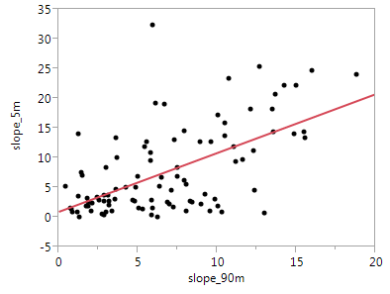
Slope is one of the first derivatives of Elevation
Slope (%) =
Rise (change in elevation)
Run (distance)
So WHAT?
R2 = 0.38
RMSE = 6.0
Notes:
So, we use slope as an example. Notice now the RMSE that is 6.0%.
Again, the influence of this difference it depends on the use purpose.
When predicting the spatial occurrence of a class (smu) or property the quality/accuracy of the input to make spatial predictions plays a major role.

Slide 12
Peeling the Errors/Uncertainty Layers
Possible sources of Errors:
Laboratory methods (precision estimates):
Between Laboratories Reproducibility (R);
Within Laboratory:
Reproducibility (R_{L});
Repeatability (r).
Field methods
Possible sources of Uncertainty (Modeling):
Pedotransfer Functions (ptf);
Spatial Data;
Spatial Predictions (Mapping);
Database Transactions;
Pedon Accuracy Locations (PLS vs GPS);
Interpretations (ongoing).
Notes:
The Terrain Attributes (TA) derived from elevation in our example are used extensively in soil mapping or digital soil mapping (DSM) as is often recognized.

Slide 13
Spatial Predictions (Mapping):
Class (SSURGO-smu / Continuous (Soil Properties)
Multiple Linear Regression (MLR)
Decision Trees (DT)
Random Forest (RF)
Kriging/Regression Kriging (K/RK)
Validations (Internal)
Cross Validation (re-sampling) mostly for validating a predictive model for deciding how many predictor variables to use in regression.
Out of bag (full model)
Leave-one-out (similar to Jackknife)
K-fold
Bootstrap and Jackknife mostly to estimate the bias and standard error (variance) of a statistic (mean, median, r, etc. by leaving out one or more observations at a time from the sample set i.e. Variability between sub-samples. Bootstrap is random variation of Jackknife.
Random subsampling (without replacement)
Notes:
In the next few examples we will discuss the merits of each model from the uncertainty perspective.
The first example is about predicting soil map units (classes) based on the soil landscape models using the already available information about soil components from official published soil surveys.
The occurrence of soil components is based on numerical characterization of soil landscape-terrain attribute relationships.
Components that differ from each other based on other characteristics other than terrain features are not distinguished. For example, Apallona, Tislit and Zanesville series occupy ridgetops but are only differentiated based on the underlying substratum which is either sandstone or shale.
In the future, however, if tools such as GPR or other sensors would be able to map the occurrence of shale and sandstone the model will be updated. For now we group them as we do with other components.
The same data set will be used for this example:
Dillon_Cr_WSH_ SD_TA.xlsx
Dillon_Cr_WSH_ SD_TA.txt
Dillon_Cr_WSH_ SD_TA.csv
The last columns provide the predicted values from different models.

Slide 14
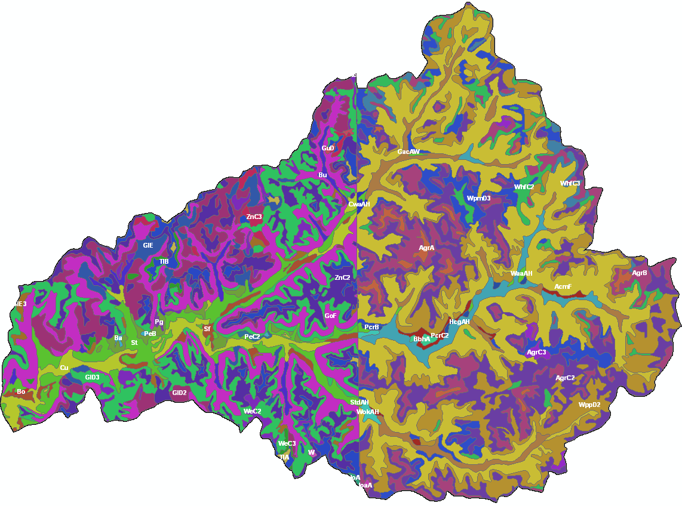
Symbol
Map Unit
Symbol
Map Unit
SSURGO SMU
Orange County
Dubois County
Notes:
This is SSURGO soil model. It is a discrete and not harmonized as shown by the county line. And there are many components over 20 series mapped.

Slide 15
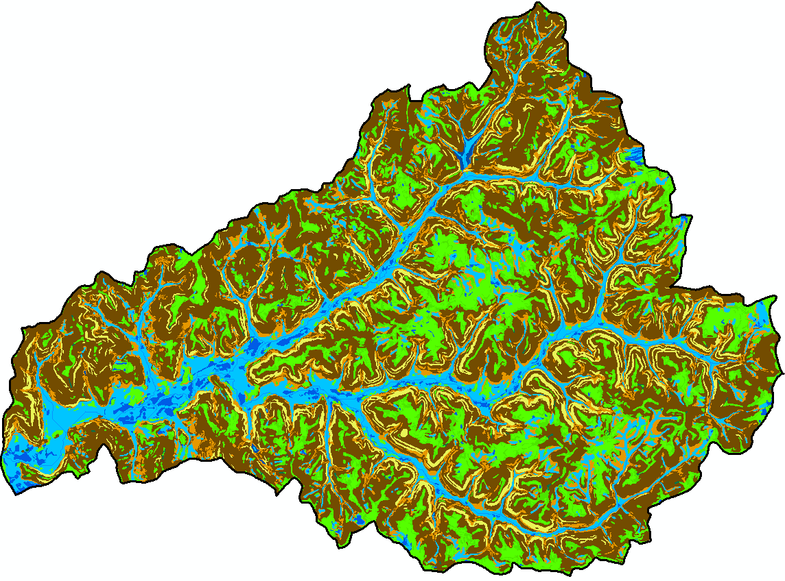
Disaggregated-Harmonized SMU
Notes:
After a correlation/harmonization (mini SDJR) using DSM techniques based on TA and fuzzy logic the map is now continuous and harmonized.
How accurate is the generated soil map compared to the original SSURGO?
It is hard to quantify this in terms of absolute truth as both SSURGO and DSM maps are models based on different tools but on the same soil-landscape model understanding.
Getting this model right is important for predicting soil properties.

Slide 16
Validation
Soil Series within SMU | Landscape Position | Accuracy Assessment
 |  | SSURGO-User | ArcSIE-Producer
Dillon Creek (Dubois and Orange Counties)
Tilsit/Bedford/Apallona/Johnsburg | Ridgetop | 0.72 | 0.86
Gilpin/Wellston/Adyeville/Ebal | Ridgetop/Shoulder | 0.80 | 0.75
Rock Outcrops/Steep Slopes | Sideslope | 1.00 | 0.90
Pekin/Bartle | Stream Terrace/Flood Plain | 0.79 | 0.74
At Soil Class Level
(Kappa Coefficient = 0.76)
Notes:
The Accuracy shows that overall there is a 76% agreement between SSURGO and Fuzzy map (ArcSIE) we call it for now.
All we can infer is that they are similar 76% of the time. And for any natural system I would have been happy with a little bit over 50% so that I don’t be in 50/50 flip coin gambling situation, which sometime is all you could have.
Of course, the ArcSIE (producer map) is simplified compared to SSURGO (User), but on the other hand is more fair and realistic approach as it places components together based on the power to predict them consistently rather than lack of reproducibility. A different soil scientist would have mapped them somewhat differently, but the same can be stated for the ArSIE approach too, however, to a lesser extend.
That sounds familiar with the reproducibility example in the laboratory methodology, except that we called that error rather then uncertainty or accuracy.
Speaking of the term “accuracy” is this term really used correctly in the context of mapping and if YES or NO why ?

Slide 17
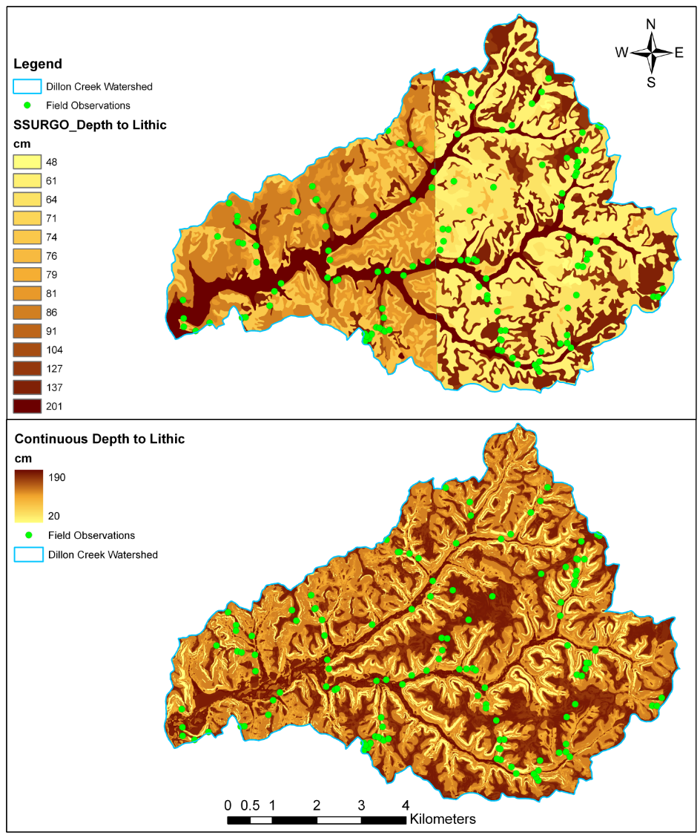
SSURGO
Validation
Just like SSURGO soil polygon maps some ground truth is necessary for QA/QC.
Continuous
Dillon Creek Watershed Study Case
Depth to Lithic/Paralithic was measured for 95 georeferenced points stratified by major slope position (summit/shoulder, sideslope, and toeslope), but collected randomly within each slope position.
Notes:
17
Placing the components on the right spatial context matters especially when generating soil properties.
As of today, attributing classes with properties is still more efficient and affordable approach of spatially predicting soil properties compared to using measured data at point locations. We may need a lot of points, and in the next example hopefully it will become clear or self-evident.
In the SSURGO soil depth map we can see clearly the “edge effect” or “Frankenstein effect” and the discontinuity of soil depth with slope position.
Big deal one might think but we need to address it for various reasons, some being:
Credibility
Modeling at regional scales
Management regional scales
and more importantly because we know it is not realistic as most of soil properties vary gradually along the slope or other terrain features. We all know about Upper and Lower Limits (ranges) about most of the soil properties and how these ranges overlap among many components, which basically admits by default that statistically there are no differences between two components for which the ranges in properties overlap.
When looking at the Continuous soil depth map one can see the pattern distribution that matches that of the landscape. This is a landscape known also as loess over sandstone and shale and because it is a relatively old landscape it has developed in three main distinct units (summits, slopes and flood plains).
Along the slopes there are sandstone benches (yellow “ribs”) where the soils are very shallow not more than 20 cm if not less. On the other hand the summits (darker) are loess caps with deep soils and floodplains (darker) are also depositional areas with deep soils as well.
This spatial representation is closer to the reality at least pattern wise, however, it is important to know how much closer is this map to the measured values (if available).
We indeed did some validation of this map at the green points that were stratified by major landscape positions but that were then randomly assigned within each position. There is a total of 95 points equally distributed among three major landscape positions.

Slide 18
Validation
Difference between measured and predictive depth to lithic/paralithic in Dillon Creek based on OSD, SSURGO and ArcSIE (PSS).
ArcSIE (PSS)
PSS-Published Soil Survey
At Soil Property Level
OSD – Official Series Descriptions
SSURGO-RV – Representative Values
PSS- Published Soil Surveys
Notes:
Out of curiosity we tried to asses the predicted maps based on OSD, PSS and SSURGO.
Overall, the difference between the mean measured and mean predicted depth to lithic/paralithic of all data sources combined for all the geo-referenced points was 26 cm and statistically significant.
The mean SSURGO difference for the summit was 95 cm and statistically significant compared to OSD
and continuous terrain attribute soil map.
The mean difference for continuous terrain attribute soil map for the toeslope was 31 cm which was statistically lower than SSURGO and OSD.
This may seem trivial but it another source of uncertainty inserted into the predicted maps simply due to the source differences. Something we as soil scientist are aware of but not most of the outside users.
The Data Files in different formats will be used for this exercise (if time permitted):
Dillon_Cr_WSH_ SD_TA.xlsx
Dillon_Cr_WSH_ SD_TA.txt
Dillon_Cr_WSH_ SD_TA.csv
Projection: NAD83 UTM 16N
Exercise: A simple R code to conduct regressions and some residuals and plot them graphically. Other comparisons can be run and be stratified by three major slope positions (Toeslope, Summit, Backslope). Print the info to see the model performance.

Slide 19
Spatial Predictions (Mapping):
Class (SSURGO-smu / Continuous (Soil Properties)
Multiple Linear Regression (MLR)
Decision Trees (DT)
Random Forest (RF)
Kriging/Regression Kriging (K/RK)
Validations (Internal)
Cross Validation (re-sampling) mostly for validating a predictive model for deciding how many predictor variables to use in regression.
Out of bag (full model)
Leave-one-out (similar to Jackknife)
K-fold
Bootstrap and Jackknife mostly to estimate the bias and standard error (variance) of a statistic (mean, median, r, etc. by leaving out one or more observations at a time from the sample set i.e. Variability between sub-samples. Bootstrap is random variation of Jackknife.
Random subsampling (without replacement)
Notes:
Now we move to another model MLR. In this example we predict soil depth based on the relationships with terrain attributes.

Slide 20
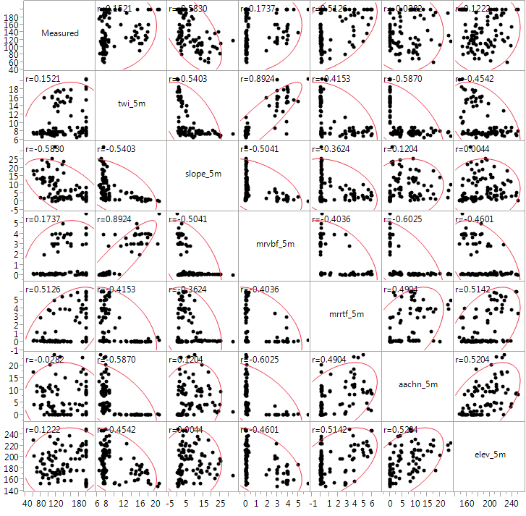
Depth to Paralithic vs. Terrain Attributes
Notice the difference in the strength of the relationships
DEM Grid Resolution 5x5 m
Notes:
Here we are looking at the relationships between soil depth and terrain attributes but also between terrain attributes themselves at the 95 field observations. All the data is in the files provided as part of this example:
Dillon_Cr_WSH_ SD_TA.xlsx
Dillon_Cr_WSH_ SD_TA.txt
Dillon_Cr_WSH_ SD_TA.csv
Projection: NAD83 UTM 16N
As expected there is a negative relationship between soil depth and slope and that makes perfect sense, I suppose. Notice also how altitude above channel network (aachn) and elevation are positively correlated.

Slide 21
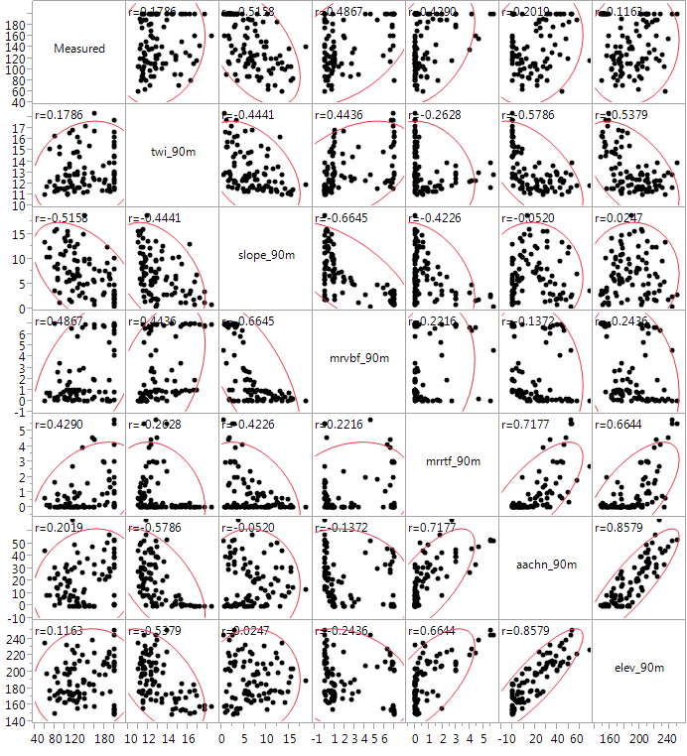
Depth to Paralithic vs. Terrain Attributes
Notice the difference in the strength of the relationships
Notice the difference in the strength of the relationships
So, WHY do we care?
Notes:
The same relationships are present but the strength of them varies for the 90m grid resolution.
So, why is this important and what does it mean in terms of data sources to be used for modeling and how does this effect the predictions based on MLR.
Things to consider:
Number of predictors (parameters);
Their predictive power;
Co-linearity;
Others
After having a discussion then we move to the next slide.

Slide 22
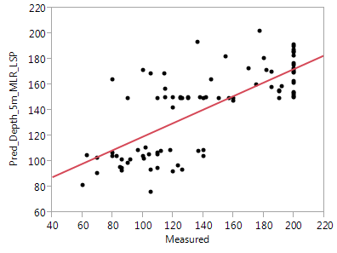
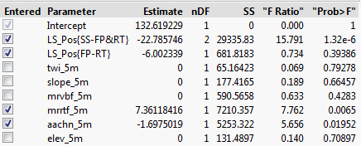
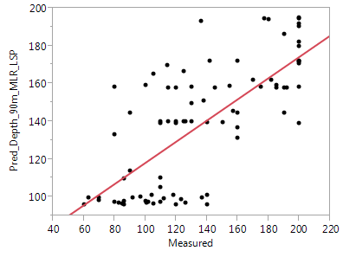
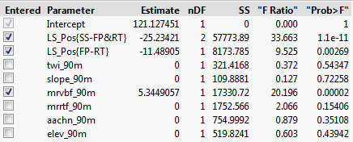
Depth to Paralithic vs. Terrain Attributes
Model: Step-wise Multiple Linear Regression (MLR)
Grid Resolution 5x5m
R2 = 0.53
RMSE = 22
Mean = 142
Grid Resolution 90x90m
R2 = 0.56
RMSE = 22
Mean = 142
Notes:
Notice that there are slight differences between the grid resolutions not so much in terms of mean, RMSE and R2 but in terms of the importance of predictive parameters.
In other words the models now are different based on the resolution and most likely will generate different predictions.
Questions to consider:
Which one to use?
How do we decide which in is better?

Slide 23
Cross-Validation (K-Fold - 10)
Grid Resolution 5x5m
Term Estimate Std Error t Ratio Prob>|t|
Intercept 140.21448 6.599797 21.25 <.0001
LS_Pos[FP] 9.1881581 6.610063 1.39 0.1679
LS_Pos[RT] 21.192836 8.344162 2.54 0.0128
mrrtf_5m 7.3611842 2.642093 2.79 0.0065
aachn_5m -1.697502 0.713793 -2.38 0.0195
RMSE R2 p R2 K-Fold (10)
32 0.53 5 0.48
Grid Resolution 90x90m
Term Estimate Std Error t Ratio Prob>|t|
Intercept 129.53885 4.072734 31.81 <.0001*
LS_Pos[FP] 5.3337568 4.41238 1.21 0.2299
LS_Pos[RT] 28.311856 4.281098 6.61 <.0001*
mrvbf_90m 5.3449057 1.189336 4.49 <.0001*
RMSE R2 p R2 K-Fold (10)
29 0.56 4 0.51
Notes:
The cross-validation (or internal one) suggests that the model is very good and explains about 50% of the variability in predictions. The only issue with this validation is that it uses the same data. In other words it is not independent and suffers from “pat your self on the back’ syndrome.
Exercise: A simple R code to explore data (co-linearity etc.), multiple regressions and some residuals and plot them graphically. Print the info to see the model performance.
The data set to be used:
Dillon_Cr_WSH_ SD_TA.xlsx
Dillon_Cr_WSH_ SD_TA.txt
Dillon_Cr_WSH_ SD_TA.csv
Projection: NAD83 UTM 16N
Questions to consider:
Is this reasonable to do? How would we improve the predictions and what would be a better independent validation approach.

Slide 24
Spatial Predictions (Mapping):
Class (SSURGO-smu / Continuous (Soil Properties)
Multiple Linear Regression (MLR)
Decision Trees (DT)
Random Forest (RF)
Kriging/Regression Kriging (K/RK)
Validations (Internal)
Cross Validation (re-sampling) mostly for validating a predictive model for deciding how many predictor variables to use in regression.
Out of bag (full model)
Leave-one-out (similar to Jackknife)
K-fold
Bootstrap and Jackknife mostly to estimate the bias and standard error (variance) of a statistic (mean, median, r, etc. by leaving out one or more observations at a time from the sample set i.e. Variability between sub-samples. Bootstrap is random variation of Jackknife.
Random subsampling (without replacement)
Notes:
Now we move to few other models:
Decision Tree (DT),
Random Forest (RF) and
Kriging.
In this examples we predict soil depth based on the relationships with terrain attributes.
We will use the same data set:
Data Files in different formats:
Dillon_Cr_WSH_ SD_TA.xlsx
Dillon_Cr_WSH_ SD_TA.txt
Dillon_Cr_WSH_ SD_TA.csv
Projection: NAD83 UTM 16N
Exercise: R code to run a single DT, RF Kriging/RG, etc. with cross validations.
The only example done is Random Forest (RF) for the next few slides.

Slide 25
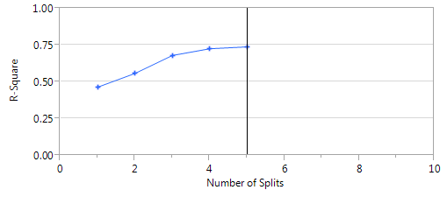
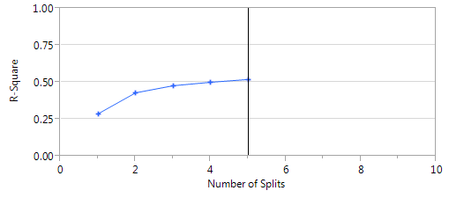
Depth to Paralithic vs. Terrain Attributes
Decision Tree (DT)
Grid Resolution 5x5m
R2 = 0.74
RMSE = 23
Number of Splits = 5
R2 (K-10 Cross-Validation=0.71
Grid Resolution 90x90m
R2 = 0.52
RMSE = 30
Number of Splits = 5
R2 (K-10 fold Cross-Validation)=0.52
Notes:
We use the same approach based on TA. The decision tree is similar to “Rule Setting”, except that in this case we are allowing the DT to make decisions for us based on similarity criteria's. The results are comparable with MLR but the 5m grid seems to be performing better (higher R2 and smaller RMSE).
In this example we used only 5 splits that equals the number of predictors. After the 3rd split the increase in R2 is not as great as before the 3rd split and at 5th split R2 levels off. The law of “diminishing return” suggests that it is not worth to increase the number of splits.
One could, of course but at the expense of complicating the model and not gaining much in return.
Questions to consider:
Would you be better off making those decision yourself like in the past when we would break the slopes from topo or elevation or let the algorithm do it for you?
What could be some of the advantages of both?

Slide 26
Depth to Paralithic vs. Terrain Attributes
Random Forest – RF (multiple decision trees)
Grid Resolution 5x5m
R2 = 0.50
RMSE = 30
Mean = 142
%IncMSE IncNodePurity
LS_Pos 8.523848 31354.48
twi_5m 4.398947 14593.82
slope_5m 8.488882 47033.06
mrvbf_5m 2.842028 14516.49
mrrtf_5m 5.473577 25607.45
aachn_5m 5.403568 14896.12
elev_5m 5.886193 18965.36
Grid Resolution 90x90m
R2 = 0.56
RMSE = 37
Mean = 142
%IncMSE IncNodePurity
LS_Pos 8.0541743 57847.00
twi_90m 5.6764586 39006.61
slope_90m -0.6012556 12780.77
mrvbf_90m 4.5352430 20681.92
mrrtf_90m 4.8972531 33573.25
aachn_90m 8.4962575 79833.75
elev_90m 2.8666882 23787.95
Notes:
The RF is a combination of multiple decision trees drawn randomly. The RF performs similarly to the MLR. Interestingly, it also selects similar predictors.
Like in the DT we are letting the algorithm make the decisions for us. We can control the number of trees and as you can see the error after 100 trees stabilizes and does not generally decrease. You can run as many trees as you want but the results may not change that much. Also each time the RF you get slightly different results due to the randomness factored in during the process.
Based on the predictions we then used kriging interpolation to make spatial predictions of soil properties.
Exercise:
We will use the data file named:
Dillon_Cr_WSH_SoilDepth_TA.txt or csv
and the DepthDC.R script

Slide 27
Depth to Paralithic vs. Terrain Attributes
Kriging and Regression Kriging
Still in Progress, Hopefully get to this by the end of the week time permitted.
However, the analysis is conducted on another software and the results are shown in the next slides
Notes:
1. fit variogram
2. eval variogram plausibility
3. make gstat object
4. predict (krige) using the gstat object
We will use the same data set:
Data Files in different formats:
Dillon_Cr_WSH_ SD_TA.xlsx
Dillon_Cr_WSH_ SD_TA.txt
Dillon_Cr_WSH_ SD_TA.csv
The columns named:
“Pred_Depth_5m_MLR”
“Pred_Depth_5m_DT”
“Pred_Depth_5m_RF”
are the predicted values for soil depth using landscape position and terrain attributes as predictors (derived from 5m grid elevation) based on Multiple Linear Regression (MLR); Decision Tree (DT) and Random Forest (RF).
The kriging is based on measured data (“column named “Measured”)
Regression kriging is based on the predicted values from the MLR plus Residuals
Random Forest is based on predicted values from RF plus Residuals.
Soil landscape Model is based on fuzzy logic (ArcSIE). You can learn more about this approach from the DSM courses (Intro to DSM and ArcSIE).

Slide 28
Kriging
Regression Kriging
Random Forest
Soil Landscape Model
Notes:
The numbers next to the field observations are the measured soil depths. Almost all interpolation methods seem to generate similar patterns and ranges in predictive soil depth.
All three interpolation methods seem to underestimate soil depth for areas around the watershed and overestimate it on the center. The soil depth map based on soil landscape model seems to make much more sense.
This is from just visual inspections, the soil landscape model seems pretty but a pretty map might as well be very wrong so we need to evaluate the property maps by comparing predictions with measured independent values that were not used as input to the models.

Slide 29
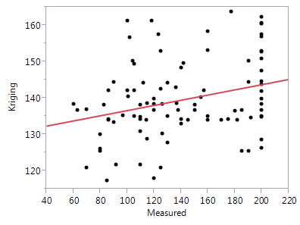
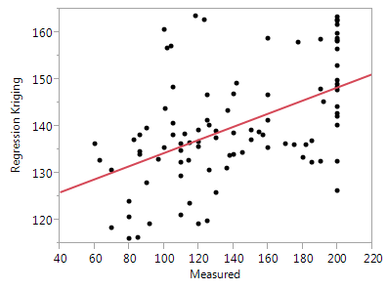
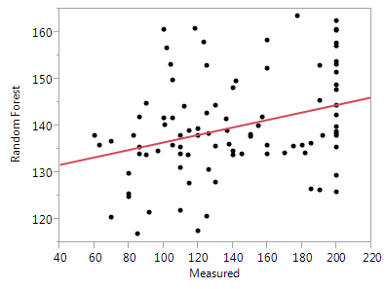
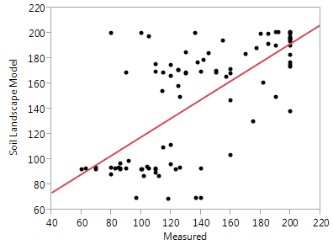
Kriging
Regression Kriging
R2 = 0.08
RMSE = 10
Mean = 140
R2 = 0.26
RMSE = 10
Mean = 140
Max
Max
Min
Min
Random Forest
Soil Landscape Model
R2 = 0.10
RMSE = 10
Mean = 140
R2 = 0.49
RMSE = 33
Mean = 149
Max
Max
Min
Min
Notes:
Here are the results from 4 spatial models as we recall from previous slides.
Before we evaluate the performance of each model based simply on R2 and RMSE it is worth noticing few things about the graphs themselves.
First, The Max-Min difference. It is smaller for all three interpolation methods but not for the soil landscape model. Why? Any guess? The term often used in such situations is “overfitting” or sometimes referred also as “smoothing”. All four models are to certain extend smoothing but the interpolation models seems to be the biggest offenders.
Questions to consider:
Why is this important?
What does it mean for modeling?
How does it effect the RMSE?
Does it seem contradictory that although the R2 for the soil landscape model is the highest the RMSE also is the highest?
How would you decide which model is better?

Slide 30
Peeling the Errors/Uncertainty Layers
Possible sources of Errors:
Laboratory methods (precision estimates):
Between Laboratories Reproducibility (R);
Within Laboratory:
Reproducibility (R_{L});
Repeatability (r).
Field methods
Possible sources of Uncertainty (Modeling):
Pedotransfer Functions (ptf);
Spatial Data;
Spatial Predictions (Mapping, Other Models);
Database Transactions;
Pedon Accuracy Locations (PLS vs GPS);
Interpretations (ongoing).
Notes:
So we discussed implications on the uncertainty resulting from analytical methods, modeling using ptf or spatial models. In the process we also discussed the implications coming from the quality of the data sources and their implications. We also briefly discussed the reliability of the data sources, using the soil depth example.
We now revisit the reliability of the data sources that often are not related to the method of measurement but database transactions. In our case we specifically discuss shortly database transection that have taken place over the years with our soil database.

Slide 31
Official Series Descriptions (OSDs)
Contained typical soil profiles with genetic horizons
(A/Ap, Bt…Cr, R and Laboratory Data)
National Guidelines (National Survey Handbook- NSH, 1983) developed to convert genetic horizons to similar layers (L1..L6) based on interpretations.
However, some states customized (fine tuned) the soil property ranges from the NSH to fill in Soil Interpretations Record (aka SOI-5).
Idaho example:
Liquid Limit/Plasticity Index and CEC
Transferred to
Examples:
OSD SOI-5
Horizon Thickness OM (%) Layer Thickness OM (%)
Ap 0-5 4.4
A1 5-15 3.6
Ap 0-10 4.6
… …
A6 170-200 n/a
SOI 5 Forms
L1
0-15
4.0
L1
0-200
4.6
Notes:
We all are familiar with OSD, NASIS, published soil surveys and some older folks with SOI- 5 and SOI – 6. They are all cousins by history. Time does not permit to dwell in the past, however we only briefly discuss the implications of such transections in terms of uncertainty.
OSD database was one of the first repositories to store lots of information about soil series.
They were recorded based on genetic horizons.
However, for interpretation purposes OSD were translated into SOI-5 and genetic horizons were aggregated and named as layers based on a perceived behavior related to interpretations.

Slide 32
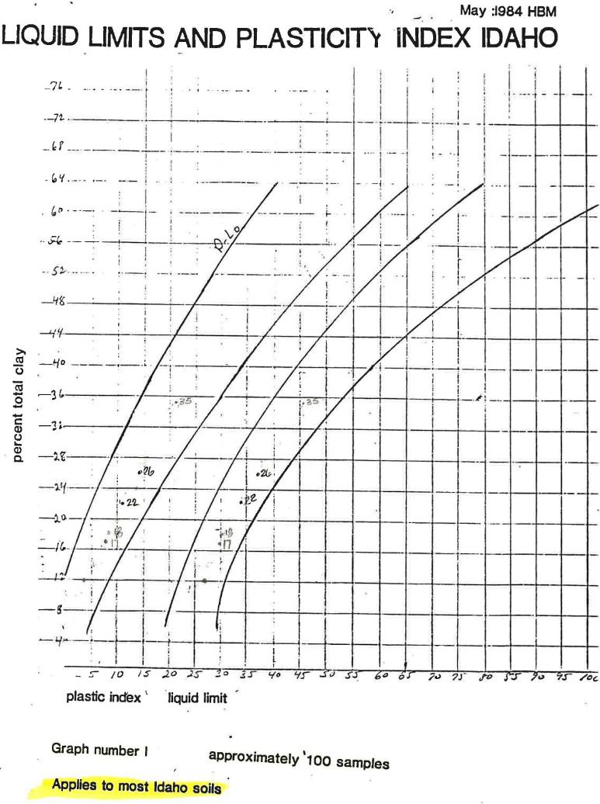
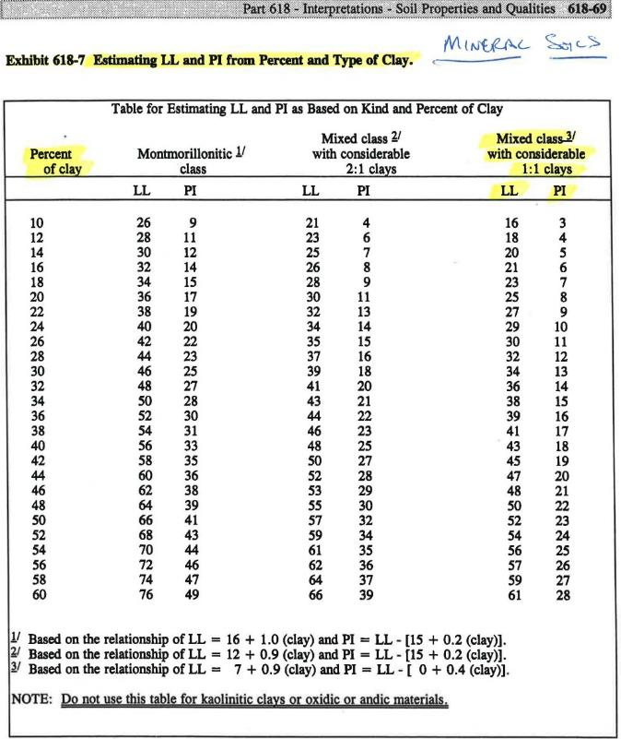
How the SOI-5 were populated
Notes:
During this transition some of the SOI-5 properties were populated with different methods like shown here for plasticity index and in the next example for CEC.

Slide 33
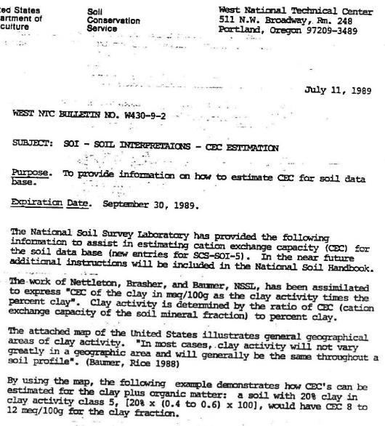
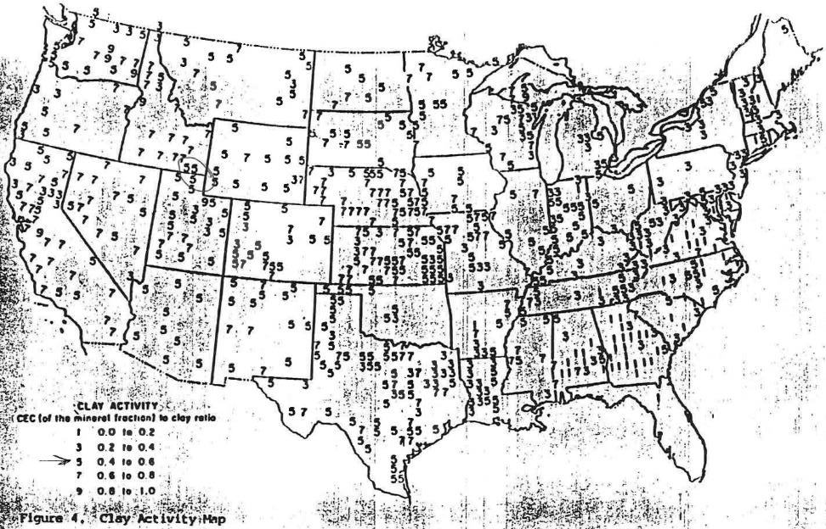
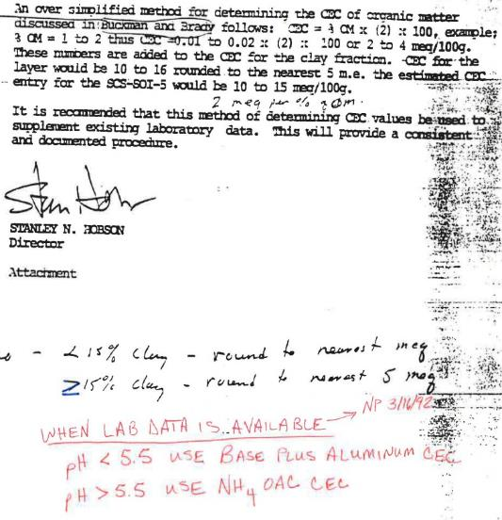
CEC Example
Rules were developed based on laboratory data and research;
Many publications appeared in SSSJ and other Journals.
For example: Donald et al., 1993. Correlations Between Field and Laboratory Measurements of Soil Color. In SSSA Special Publication No. 31.

Slide 34
Populated via different venues:
Laboratory Data Analysis;
Field Observations;
Rules (not always followed):
Within 75-80% (2St.Dev.) of Lab. data when more than one pedon available.
UL and LL populated with Class Limits derived from Field Observations when less than one pedon available.
Official Series Descriptions (OSDs)
SOI-5 Forms
Soil Series Database
Ames, Iowa
Top-Down Approach
SOI-6 Forms
Soil Survey Report Tables
Published Soil Surveys
SOI-6 (Map Unit Record) tracked which phases on SOI-5 were used for a map unit:
Depths and number of layers were modified to reflect local conditions.
Slope;
Range site (Ecological Site Description).
Some States edited SSSD to match with Published Soil Surveys
State Soil Survey Database
SSSD
and/or edited SSSD to fit local conditions
In 1994
National Soil Inventory System
NASIS
Bottom-Up Approach
Notes:
The major database transactions, at least admitted from several sources and interviews, that took place were:
Top-down Approach using Soil Series database (Ames, Iowa) – to assign properties to series or components wherever it was mapped. Then along came NASIS in 1994 and
A bottom-up approach was recommended by assigning soil properties from a combination of field and lab data to better reflect the tacit knowledge of the surveyors.

Slide 35
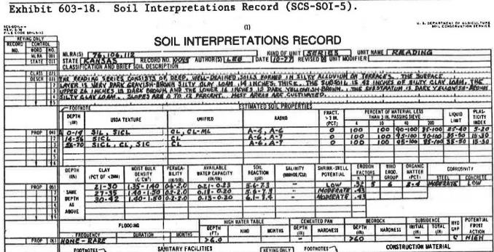
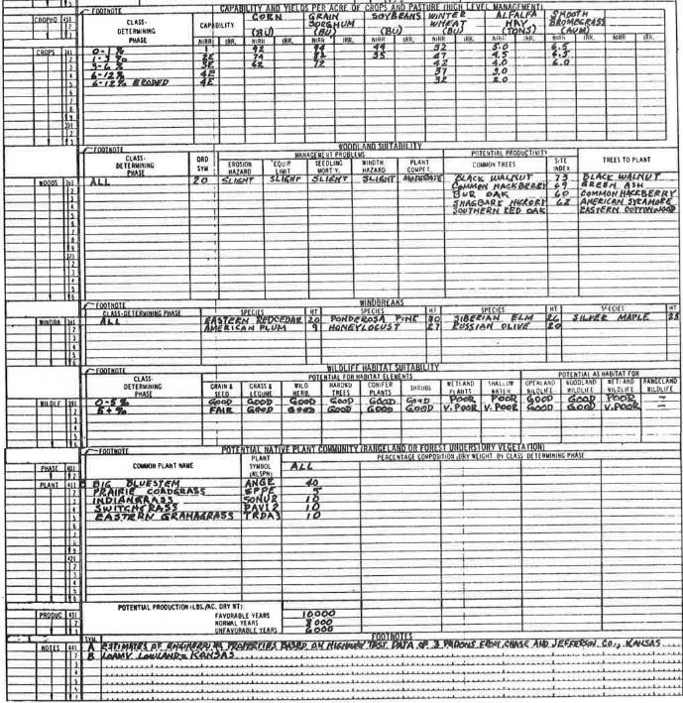
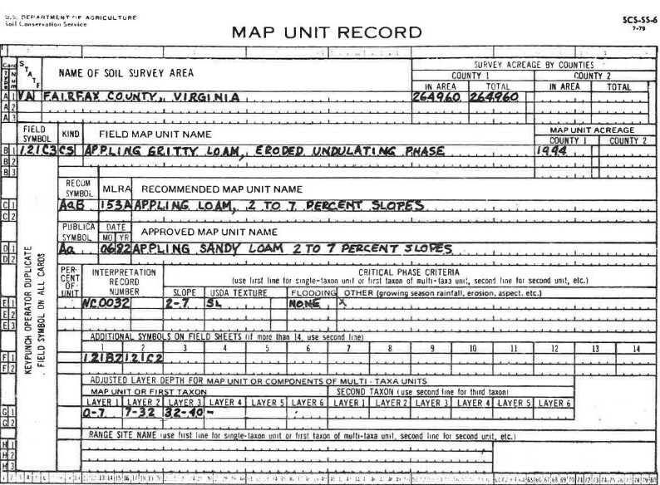
SOI - 5
Select:
the appropriate phases from SOI-5:
Surface texture;
Slope;
Range Site (Ecological Site Description)
to populate SOI-6
SOI - 6
Notes:
Here an example of how this was executed.
SOI-6 is used to select the appropriate phases (surface textures, slope, range site, corps) from SOI-5.
Not all the layers were selected and the depths were modified to represent local conditions.
Again the purpose of this transaction was to reflect the tacit/local knowledge captured by correlation documentations/field observations.
However, in the process, a source of uncertainty was created by selecting specific properties and transferring them to another form and more importantly adjusting the numbers to modify the local conditions.

Slide 36
National Soil Inventory System
NASIS
NASIS Rationale:
Interpretations developed based on actual soil properties;
Data capture at field level; (“bottom up” instead of “top down”);
Multiple Components (SOI 6 limit was 3);
Multiple Horizons (SOI 5 limit was 6);
“RV”s - Representative Values for Modeling.
Is under constant editing as data and/or observations become available
Soil Data Mart (SDM)
Published Snapshot of NASIS
http://soildatamart.nrcs.usda.gov/
The end result: several sources are now available with different soil property values for the same soil map units.
Soil Survey Geographic Database
SSURGO
State Soil Geographic Database
STATSGO2
http://soils.usda.gov/survey/geography/ssurgo/
http://soils.usda.gov/survey/geography/statsgo/
Notes:
The unintended consequences of this were
The circulation of many data sources for the same set of soil properties,
Inconsistent population of the databases via a mixture of lab, field and tacit knowledge (aka pull out of your hat approach).
Poor documentation of the transects that took place decision being made and on and on.
The bottom-line is that all these decisions do have a direct impact on the uncertainty of our predictions.
How do we asses these impact quantitatively? There is not one single solution and people can argue in favor of one approach versus another. This is beyond the scope of our focus so we take one approach by comparing populated values on NASIS/SSURGO with measured ones.

Slide 37
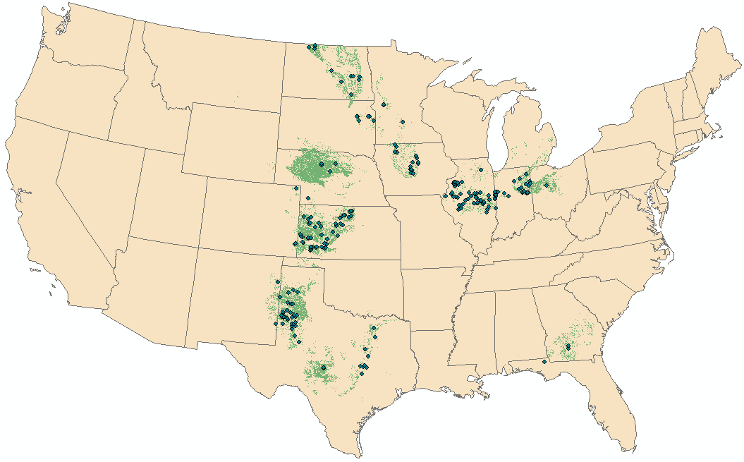
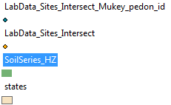
Mapped Soil Series with > 1 Million acres
No. | Soil Series | No. Counties | Acres
1 | Valentine | 50 | 8,830,725
2 | Pullman | 19 | 2,730,955
3 | Richfield | 11 | 2,133,203
4 | Williams-Bowbells | 4 | 1,541,068
5 | Holdrege | 22 | 1,445,344
6 | Amarrillo | 24 | 1,391,065
7 | Tifton | 31 | 1,364,750
8 | Harney | 2 | 1,340,139
9 | Clarion | 30 | 1,322,296
10 | Tarrant | 6 | 1,301,328
11 | Huston Black | 29 | 1,181,216
12 | Pewamo | 43 | 1,153,697
13 | Barnes-Svea | 6 | 2,165,298
14 | Barnes- Buse | 4 | 1,003,934
15 | Ulysses | 9 | 1,125,247
16 | Olton | 19 | 1,050,027
17 | Drummer | 7 | 1,046,356
18 | Clime-Sogn | 15 | 1,031,900
19 | Nicollet | 27 | 1,029,574
20 | Ipava | 5 | 1,024,960
Notes:
For this purpose, we selected the soil series with more than 1 million acres mapped in hopes to have a sample size of measured pedon data big enough to allow for the calculation of some simple statistics such as mean and standard deviations.
The idea is to compare the measured mean and +/- 2 standards deviations from the measured data and compare them with the estimated RV and upper and lower limits to asses how far numerically are these statistics from each other.
In a sense, it may not be a fair comparison, but under the circumstances it may tell us something about where these NASIS populated data came from.
So, Why is this important? Think of users taking these data and running other models from them.
We revisit our soil pH example.

Slide 38
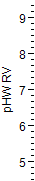
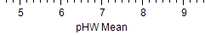
Soil Series/Types
pH RV. vs. Arithmetic Mean by Soil Series
pHW RV = 0.098 + 0.99*pHW Mean
R² = 0.96
RMSE = 0.16
Mean of Response = 7.1
Observations = 11056
Notes:
This comparison includes all the observations and does not differentiate between horizons.
Ideally, we would prefer to do it on a 1:1 basis comparisons where the estimated values from one horizon matches that of measured values for the same horizon. For reasons explained previously this is not possible so in this sense the comparison is not fair. So we instead included all the observations.
Thus is may not have a lot of use, other than overall there seem to be a consistency in populating the RV with the arithmetic mean of the UL and LL.
It still does not address the question about where die the RV and UL and LL came from?

Slide 39
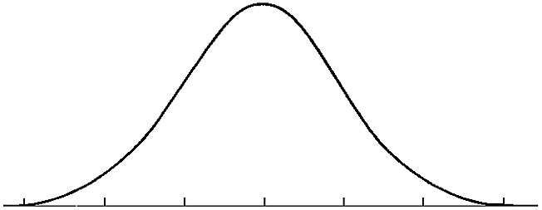
Class vs. Confidence Limits pH example
RV/Pedon
(Mean of the LL)
(Mean/Median of the UL)
(Lowest/Median of the LL)
2.5%
97.5%
(Highest of the UL)
- 2 St.Dev.
+ 2 St.Dev.
5.6/5.3
6.1
6.8/6.9
7.7/7.8
8.4/8.5
68.2%
95.4%
99.7%
Notes:
In this example for simplicity the UL and LL and RV are compared wit the mean and +/- 2 StDev from pedon data.
It is re-assuring to see that the values are not far from each other, however, this is a source of uncertainty introduced in our data in addition to the errors associated with measurement themselves.
We are in the business of spatial modeling and these errors/uncertainty will be carried to the next stage where we are trying to predicts soil properties spatially between points.

Slide 40
SSURGO_RV_Clay vs. Measured Clay
Surface Horizons
SSURGO_RV_Clay = 3.9 + 0.7*Measured_Clay
R2 = 0.72
RMSE = 5.3
Mean of Response = 23.5
Observations 281
Notes:
Clay is another interesting example as many NASIS tables have been populated with field measured textures.
Again trying to be fair to the comparison and avoid as much as possible any sources of variability the surface horizons were compared.
In this example is appears that on average the field soil scientist were off by 5.3% for clay content.
Are you surprised?
Why some of the data on the SSURGO RV appear to be lines instead of randomly spread out like the measured ones?
Recall the same for the soil pH.
How does this effect the uncertainty?

Slide 41
Class vs. Confidence Limits - Clay example
RV/Pedon
(Median/Mean of the LL)
(Median/Mean of the UL)
(Lowest of the LL)
2.5%
97.5%
(Highest of the UL)
- 2 St.Dev.
+ 2 St.Dev.
3/3
18/19
24/25
27/28
60/47
68.2%
95.4%
99.7%
Notes:
Just like the soil pH example there seem to be a good agreement between estimated and measured values.
The spatial predictions are obviously sensitive to such deviations from the measured values.

Slide 42
Peeling the Errors/Uncertainty Layers
Possible sources of Errors:
Laboratory methods (precision estimates):
Between Laboratories Reproducibility (R);
Within Laboratory:
Reproducibility (R_{L});
Repeatability (r).
Field methods
Possible sources of Uncertainty (Modeling):
Pedotransfer Functions (ptf);
Spatial Data;
Spatial Predictions (Mapping, Other Models);
Database Transactions;
Pedon Accuracy Locations (PLSS vs. GPS);
Interpretations (ongoing).
Notes:
Recently, it has become obvious that the location accuracy of pedon data is not something to be taken for granted.
There is an on-going work on this.

Slide 43
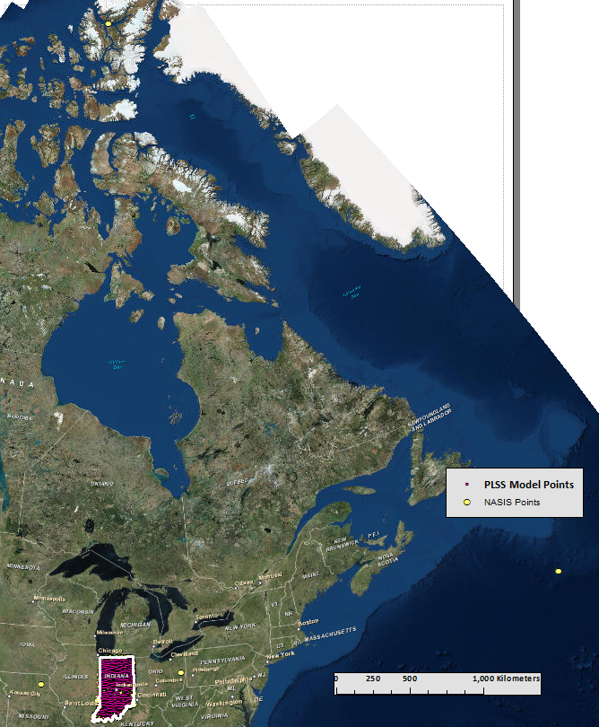
U.S. Soil Survey Pedons for Indiana in their Official Locations
Pedon placed in :
Greenland,
Atlantic Ocean
Kansas
Ohio
Notes:
In spatial predictions, especially geostatistics this is very influential on the outcome of the predictions. Recall the Dillon Creek watershed. In that example there may have not been enough data points for a meaningful interpolation. Adding more layers to the uncertainty some of the points are not to where they are supposed to be. This may or may not be important depending on what we are trying to predict and at what scale. We will not get to this but just a question to consider.
Questions:
Can you think of a case where few data points would be adequate and another one where even a highly dense data point might not be enough for reliable prediction./ Don’t get hung up on the word “reliable”.
In this example from Indiana few NASIS pedon points have coordinates that place them outside of the state and even the country.
Some errors could not be corrected with confidence therefore, these points were eliminated from the study.

Slide 44
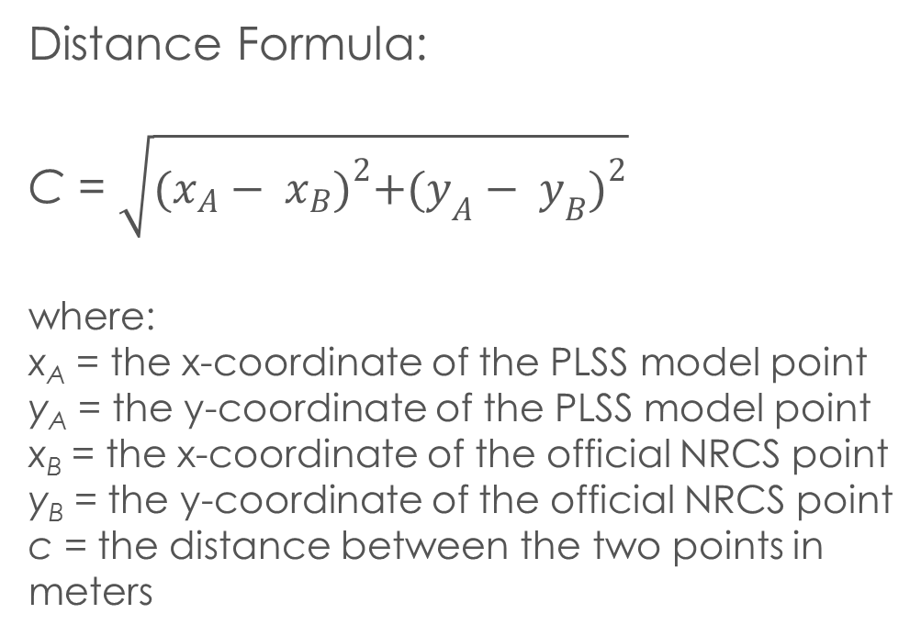
Comparing point locations
Distance Formula:
C = $\sqrt{{(x_{A}− x_{B})}^{2}+{(y_{A}− y_{B})}^{2}}$
where:
x_{A} = the x-coordinate of the PLSS model point
y_{A} = the y-coordinate of the PLSS model point
x_{B} = the x-coordinate of the official NRCS point
y_{B} = the y-coordinate of the official NRCS point
c = the distance between the two points in meters
Notes:
The first thing we looked at was the PLSS influence since we use that grid to locate the pedons using PLSS descriptors.
So, there is a great variability in terms of distances between PLSS and NRCS. For less than half of the samples (40%) the distance varies from 0-10 m and for about 38% of the pedons the distance goes from 10-500 m and only about 22% the diatance varies from 0.5 km to 5 km.

Slide 45
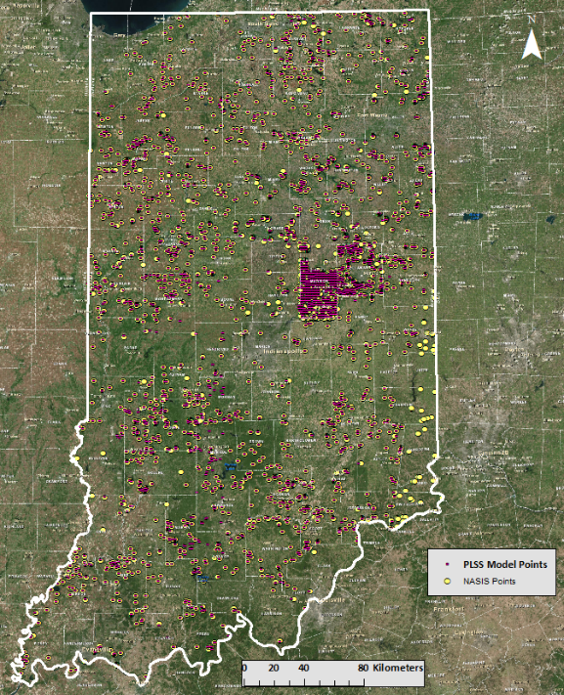
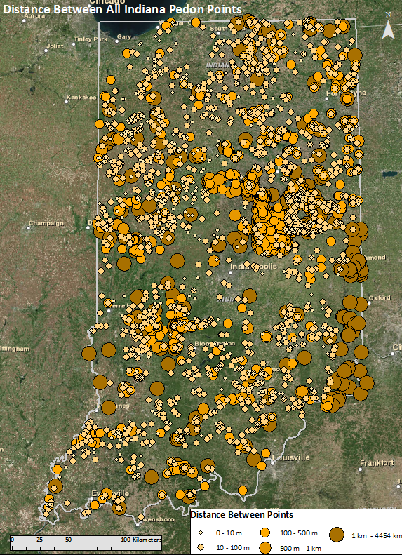
Comparing point locations
Notes:
Spatially we can see where the differences are larger.
Questions to consider:
How does this affect interpolations?
Where would this discrepancy between locations would be critical and where it might not matter?
Consider the scale and soil property.
Can this be fixed? And if yes How?
There are ways but some of them may require a lot of work.

Slide 46
Semi-Automated Model Structure
✓
PLSS 5-point System
✓
Regrouped Geomorphons
Ruhe’s Hillslope Position
Extract Multi-Values to Points (No Buffer)
PMs
✓
OSD Series
✓
Drainage class
gSSURGO mukey/mapunit
Slope Position
PMs
Series in Soil Surveys
✓
Drainage class
Slope Position
Extract Multi-Values to Points (Buffer)
Mismatched Points
✓
Same as above
PMs
Manually match soil properties (Buffer)
New Point Shapefile w/Inaccuracy Index
✓
Drainage class
Slope Position
Notes:
One approach developed and is still in progress is to extract information related to terrain attributes and landscape features from the current locations and compare them with the descriptions and see for mismatches. Ideally an independent sours of measured point data would best but not realistic and affordable.
It is tedious work and requires a lot of prior knowledge.
Question for discussions:
Is this worth pursuing?
Before you rule YES or NO or MAYBE consider the “law of diminishing return”. In other words consider the investment for each site to be visited, sampled and analyzed and what we gain potentially by correcting them.
Does it really matter in the end given all sources of uncertainty we discussed?

Slide 47
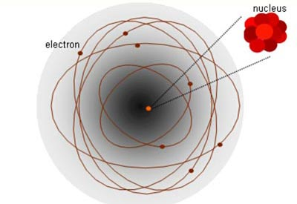
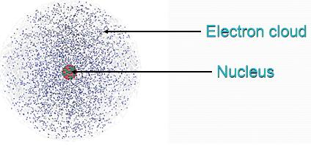
Uncertainty is Certain
The Degree is Uncertain
www.sciencebuddies.org400 × 275Search by image
www.thinglink.com424 × 198Search by image
Notes:
Question: This is more of a Philosophical take on the Uncertainty. Picture a single spherical or ellipsoid line is a model of an infinite probabilities of the electron’s position around the nucleus.
What does this atom structure tells about the Uncertainty?

